Slide 1

Stock price prediction using deep learning
Ganesh Anirudh Panthula
Prof: Dr. Simon foo

Slide 2
Dependencies
Model Uses closing price to train neural network and predicts the direction of stock
Data used – S&P 500 companies history of closing stock price from 2010 to 2016
Dependencies – Keras on Tensorflow Backend, Amazon Web Services

Slide 3
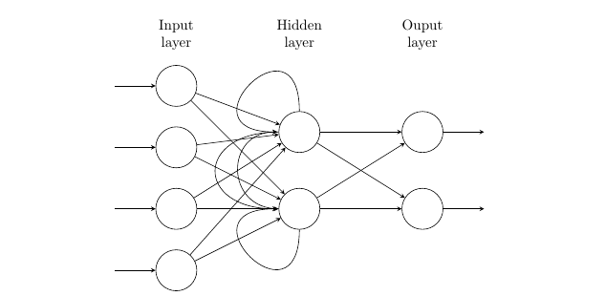
Recurrent neural network
Time series is a series of data, listed in the order of time
Rnn is used for sequence problems
Vanishing gradient problem

Slide 4
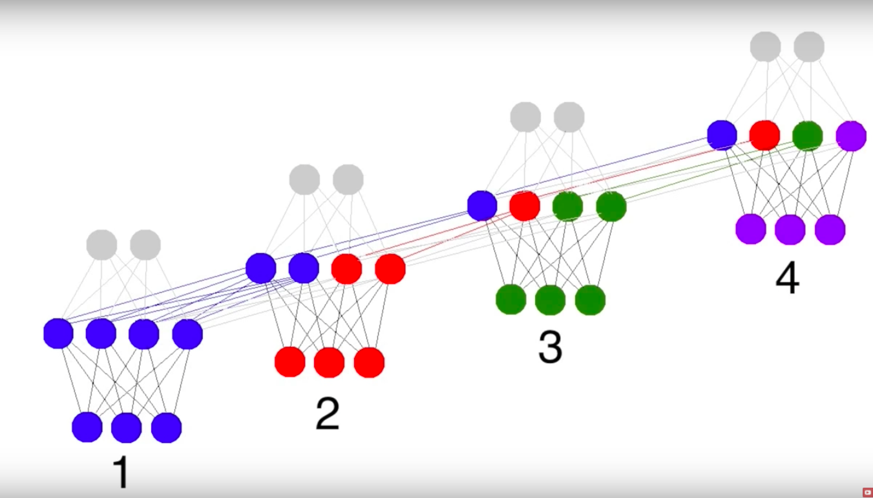
Long short term memory
LSTM is a type of RNN
Solves the long term dependency problem of RNN
It is a series of memory cells stacked together which have gates to keep relevant information

Slide 5
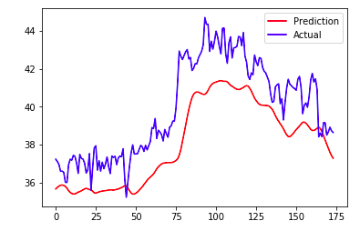
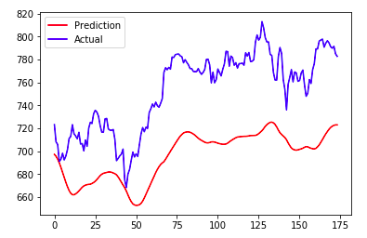
Results
Yahoo stock
Google stock

Slide 6
Stock analysis
Model has an accuracy of 81%
Calculate the chances of a company to go bankrupt
What is the return on an investment
Which stock is undervalued
Reinforced learning can be used to increase the accuracy

Slide 7
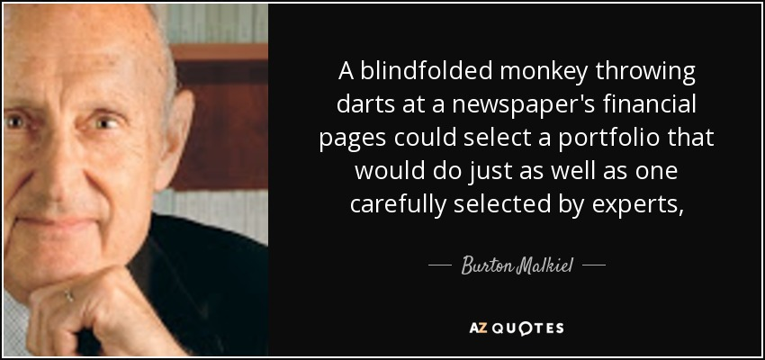
can you make money with this model ?

Slide 8
Questions ?

